Slide 1
Understanding & Reducing the Cost of Card Payments
January 12, 2017
Anand Goel
anand@optimizedpmts.com
404-542-8520 phone
888-846-1305 fax
September 20, 2018
Anand Goel
anand@optimizedpmts.com
404-542-8520 phone
888-846-1305 fax

Slide 2
Optimized Payments Consulting
Background
  Founded in 2007; privately held
  Headquartered in Atlanta
  Professional staff from payments industry
Service offerings
  Payment analytics
  Payments consulting - fee audits, RFPs, network negotiations
Client profile
  Retail, Internet, b2b, healthcare, telecom merchants
  Mostly Fortune 2000

Slide 3
Objectives
Understand the 3 key components of card processing costs
Learn best practices in “optimizing” interchange and acquiring fees
Learn a framework for simplifying and analyzing payments data
Q&A

Slide 4
Components of Card Fees
For large merchants (annual card sales of $100M+), Interchange represents about 85% of the total cost and assessments represent 8% of the total cost
Interchange fees can be managed and in some instances, negotiated with the card networks
Processor and gateway fees average 7% of total cost

Slide 5
Understanding Interchange
Interchange (IC) is defined as the wholesale price, charged by Visa/MasterCard/Discover, for settling a credit/debit card transaction
All the IC that a merchant pays goes to the bank that issued the card
  For instance, if you use a Citibank Visa credit card at a Macy's department store and charge $100 - the IC cost of $1.61 (Visa CPS Retail at 1.51% + $0.10) goes to Citibank
Visa & MasterCard interchange tables are available through their respective websites. Discover interchange tables are available through acquirers.
For issuers, interchange revenue pays for 1) cost of money, 2) rewards programs, 3) internal costs including fraud and 4) profit
The U.S. has the highest credit interchange rates in the developed world

Slide 6
Why So Many Rates?
Visa/MC/Discover have setup a complex scheme of 700+ interchange rates. Various considerations are involved in how interchange rates are set in the U.S.…
Macro Considerations
  Competition amongst card networks
  Card network and issuer strategies
  Emerging markets/verticals
  Legislation
Micro Considerations
  Merchant's industry type (MCC – Merchant Category Code)
  Type of card (Visa Traditional, Visa Rewards, Visa Signature, Visa Debit, etc.)
  Method of entry (swiped vs. keyed)
  Risk and adherence to compliance standards

Slide 7
Controllable vs Uncontrollable Factors
Uncontrollable factors
  Type of Card (e.g. Visa Traditional, Visa Rewards, Visa Signature, Visa Debit, etc.)
  Your Merchant Category Code (MCC)
  Method of entry (e.g. swiped/dipped vs. keyed/CNP/Ecommerce)
  Transaction amount/ticket size
Controllable Factors
  Business processes (AVS, timeliness, etc.)
  Transactional data attributes (Level II and Level III data)
  Network routing

Slide 8
Optimizing Interchange
All interchange can be grouped into seven meaningful categories
  Consumer traditional cards
  Consumer rewards cards
  Signature debit cards
  Commercial cards
  International cards
  Downgrades
  Refunds
Not all interchange categories can be improved…only downgrades can be optimized to receive lower interchange rates
In certain retail scenarios, signature debit cards can be optimized through “PIN prompting”

Slide 9
What is a Downgrade?
A downgrade occurs when a transaction does not receive the best available interchange rate
Examples of downgraded interchange rates include:
  Visa
    EIRF
    Standard
    Commercial Retail, CNP and B2B
    Commercial Level II*
  MasterCard
    Standard
    Commercial Data Rate I
    Commercial Data Rate II
    Commercial T&E I (depends on the industry and ticket size)
    Commercial T&E II (depends on the industry and ticket size)
  Discover
    Mid Submission
    Base Submission (Consumer and Commercial)
*depends on card type

Slide 10
What are common reasons for downgrades?
Below are some of the most common reasons for downgrades:
  Not performing AVS (Address Verification System) for key entered or card not present Visa Cards
  Adherence to compliance standards
    Electronic authorization
    Authorization vs. settlement timing
    Authorization vs. settlement $ amount tolerances
  Not submitting Level II or III data for commercial cards (business, corporate, fleet and purchasing cards)
  Missing industry specific data for the travel industry
    Lodging data (Check-in/out dates, folio, customer service number)
    Airline passenger data (ticket number, passenger name, itinerary data, ancillary data)

Slide 11
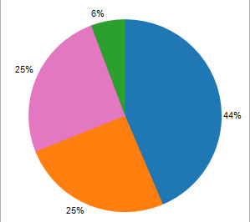
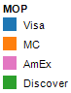
Understanding Card Networks
Card networks work with banks to issue credit and debit cards
Card networks earn assessments (~0.13%) and dues (~$0.02) for each txn in addition to other ancillary fees
International/Cross Border Fees can be significant
AmEx contracts directly with merchants with exception of small merchants processing <$1MM in AmEx sales per year. Small merchants can contract AmEx through their acquirers/ISOs via OptBlue program.
Card Network Market Share
Notes: American Express is a network and issuer of its own cards. Market share data based on 2011 credit card purchases…data from February 2016 Nilson Report.
Notes:
11

Slide 12
Assessments & Dues
Assessments & Dues are the second largest cost of card processing
Make up about 7-15% of cost
Paid directly to the card associations and cover the operating costs of managing these networks
Assessments range from 0.12% to 0.14%
  Flat-rate percentages charged against total gross monthly sales
Dues is a grouping of various other miscellaneous fees
Currently about 30 different assessments and dues fees in the US
While all card processors are subject to the same assessment fees, some processors may markup these fees to the merchant
Most dues are not able to be optimized, there are a few that may be reduced

Slide 13
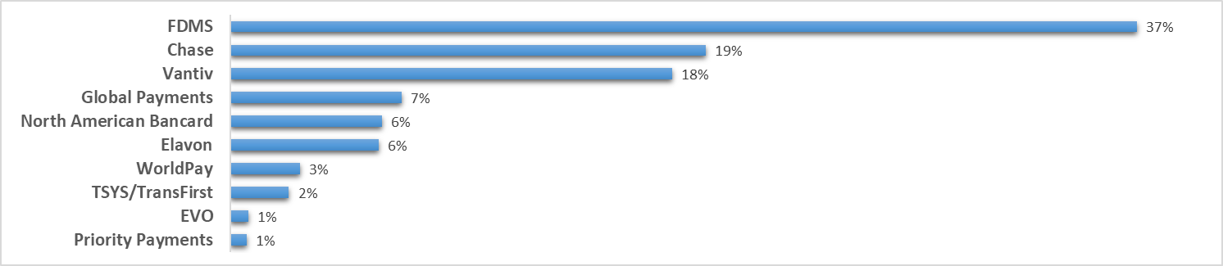
Understanding Merchant Acquirers
Acquirers link merchants to the card networks and provide authorization, settlement, service and reporting services. If a merchant goes out of business, the acquirer is liable for all chargebacks.
The top 10 acquirers process roughly 90% of the card sales in the U.S.^{1,2}
There are about 1,400 ISOs (Independent Sales Organizations) that resell card services for these 10 acquirers
¹Data compiled from March 2017 Nilson report. Rankings based on total credit, signature debit and PIN debit sales for 2016.
²First Data Merchant Services ranking includes joint ventures with BofA, Wells Fargo and PNC and bank alliances

Slide 14
Acquirer Fees
For large Enterprise merchants, Acquirer fees make up about 1-5% of the total cost of card processing
These fees are charged by the payment processor or merchant acquirer for authorization, settlement, reporting and account management services
Acquirer fees can include the following (all negotiable):
Other notes:
  If you have multiple sales channels with multiple merchant accounts, consolidate for better pricing and security management
  Understand your contract
  Invest time to understand nuances of industry or get expert to sift through pricing proposals

Slide 15
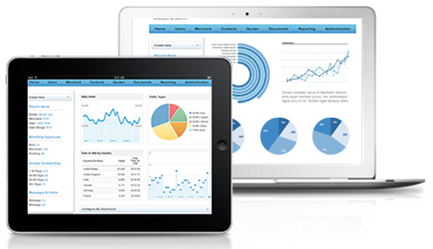
Defining Payment Analytics
Payment Analytics are visual tools used to understand and manage your organization’s payment data.
The more complex the payment process, the more difficult it is for organizations to adopt a holistic approach to understanding their payments process and costs.
If payment costs cannot be tracked or analyzed, they cannot be improved.

Slide 16
Why Use Analytics in Payments?
Payment instruments vary in use, cost, and performance. Applying payments analytics provides awareness and insights that are actionable.
Analytics allow you to:
Proactively identify problems/trends and apply corrective measures before they become an issue
Monitor primary cost drivers
Understand cost components that can be controlled and managed
Understand your overall effective costs
Direct customers to lower cost options
Identify best practices to be applied throughout the organization.

Slide 17







How to Build an Analytics Process?
Identify Key Metrics
Identify key payment metrics that are important to your organization
Gather Data
Consolidate daily or monthly raw data from all payment sources including, acquirer(s), Discover, American Express, private label cards, gift cards, PayPal
Organize Data
Normalize all payment tenders and categorize data using uniform taxonomy (one-time setup required)
Segment Data
Apply relational tables (e,g, interchange qualification, MID) to further refine your data
Analyze Data
Apply BI tool to link relational tables and analyze data. Publish or share data with your internal stake holders

Slide 18
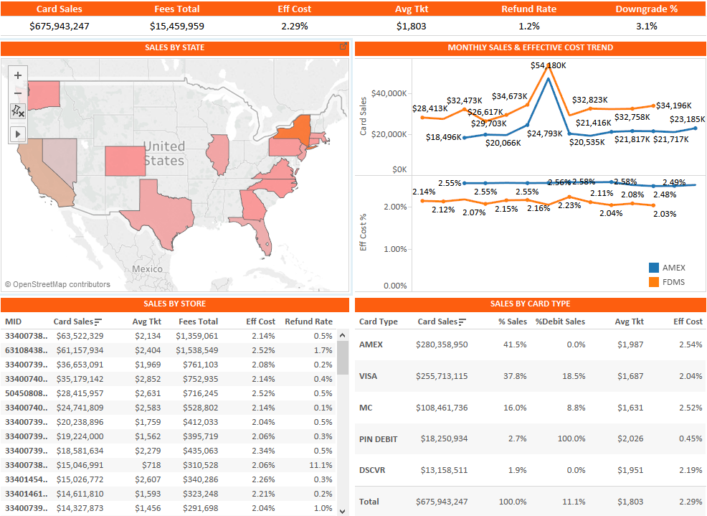
Create Complete View of Payments

Slide 19
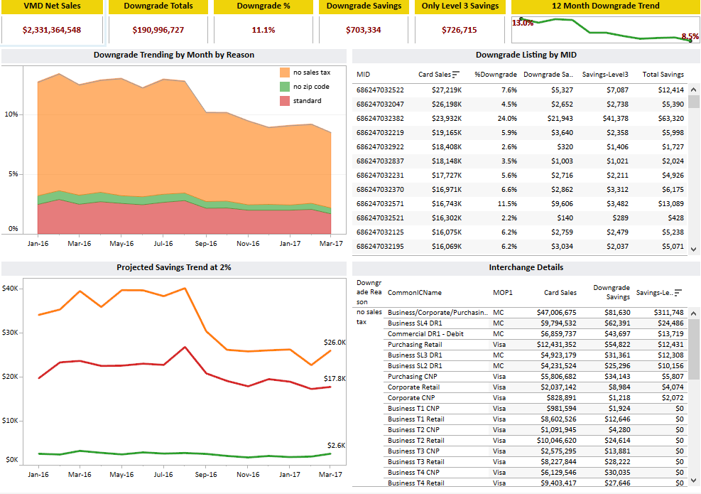
Visualize Downgrade Costs

Slide 20
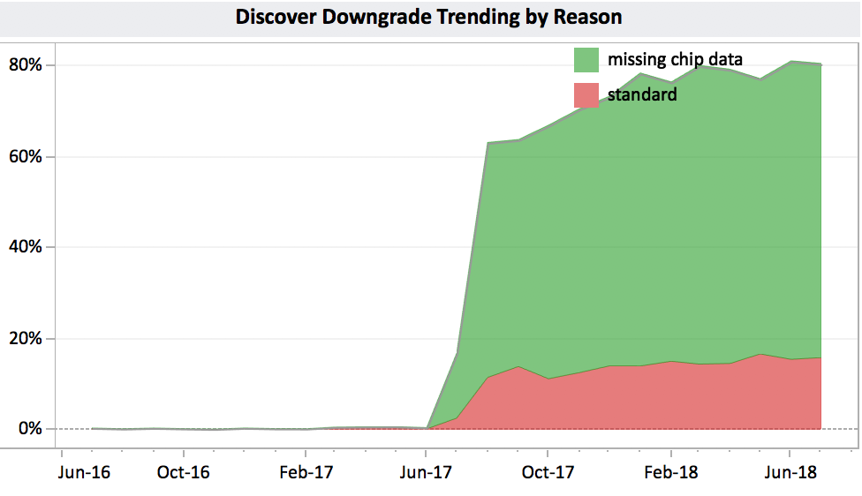
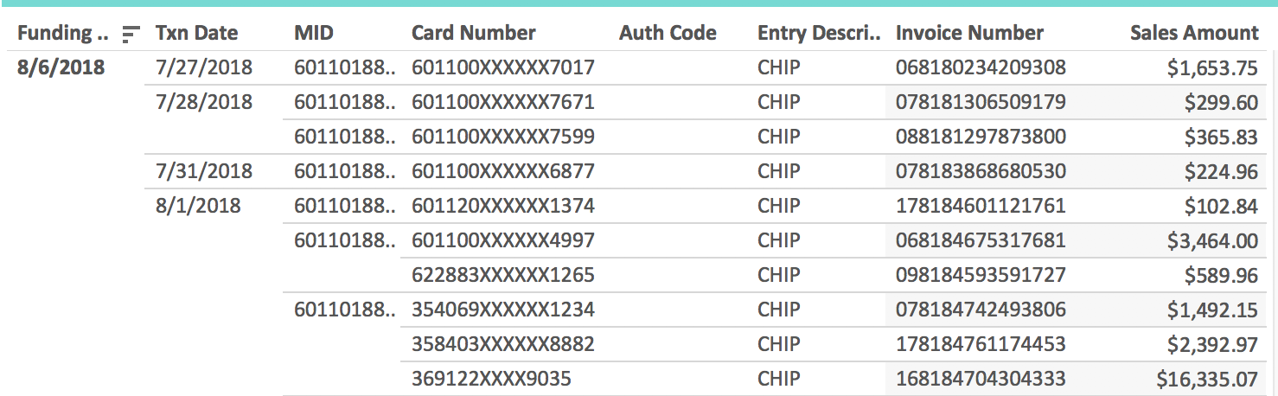
Highlight Inefficiencies
Gateway chip card issue costing merchant $20K per month
Issue started when chip terminals were implemented in July 2017
Transaction level detail shows specific chip transactions that downgraded

Slide 21
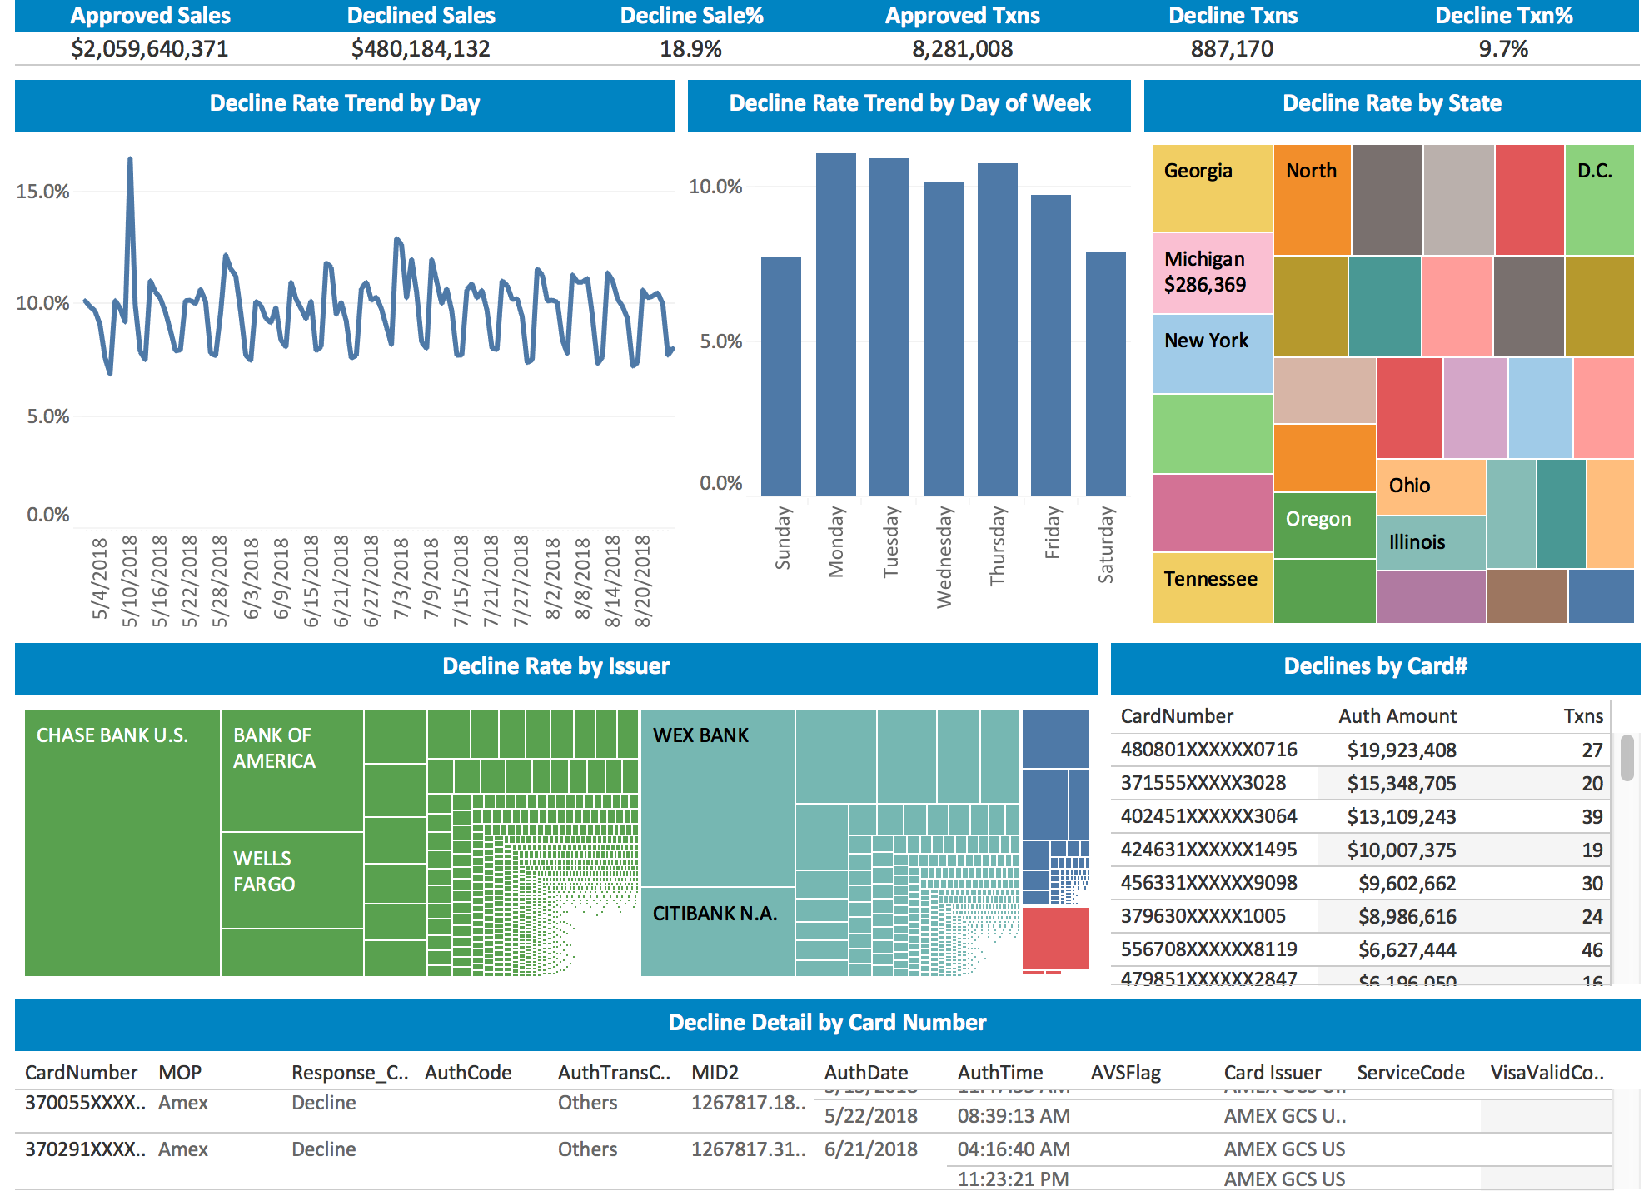
Understand & Improve Declines
Identify & improve reasons for declines
Isolate issues with specific MIDs, issuers, etc.
Identify excessive auth attempts

Slide 22
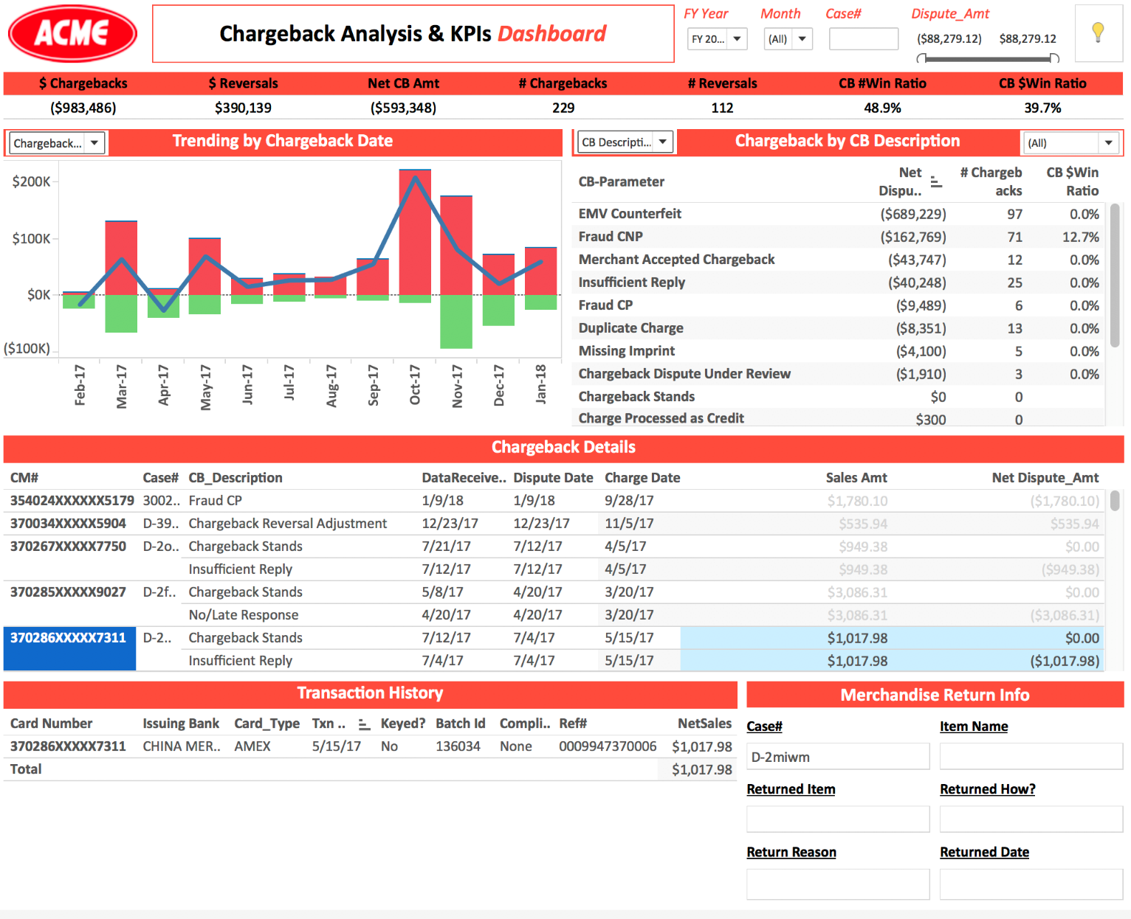
Understand & Manage Chargebacks
Link chargeback to original sale(s)
Identify opportunities for improvement
One source for all vendor chargebacks
Track win rates and reason codes

Slide 23
Summary of Best Practices
Track your effective cost of card payments on a monthly basis
Implement payment analytics to understand KPIs and identify opportunities
Reduce downgrades
Benchmark processing fees
Engage your processors…ask questions

Slide 24
Q & A
What questions do you have?
(There is no such thing as a bad question!)

Slide 25
Thank You!
Anand Goel
anand@optimizedpmts.com
404-542-8520

